Slide 1


HuBMAP + HPA - Hacking the Human Body Competition Progress Report 2
Presentation of a Report
By
Juntuo Wang, Yufen Gao
Notes:
English Title: Uppercase, Calibri size 60, XJTLU Navy
English Subtitle: Uppercase, Calibri size 36, XJTLU Navy

Slide 2


Overview
A Introduction of A Better Baseline:
1. A brief introduction to the UNext50 model (Better Baseline)
Analysis of results:
1. Comparison analysis between different baselines (UNext50 and UNet++)
2. Comparison analysis between data augmentation strategis
Future Plan:
1. A plan for further model performance improvement
Notes:
Header: Uppercase, Calibri size 28, XJTLU Navy
Body Text: Sentence case, Calibri size 14, Black

Slide 3
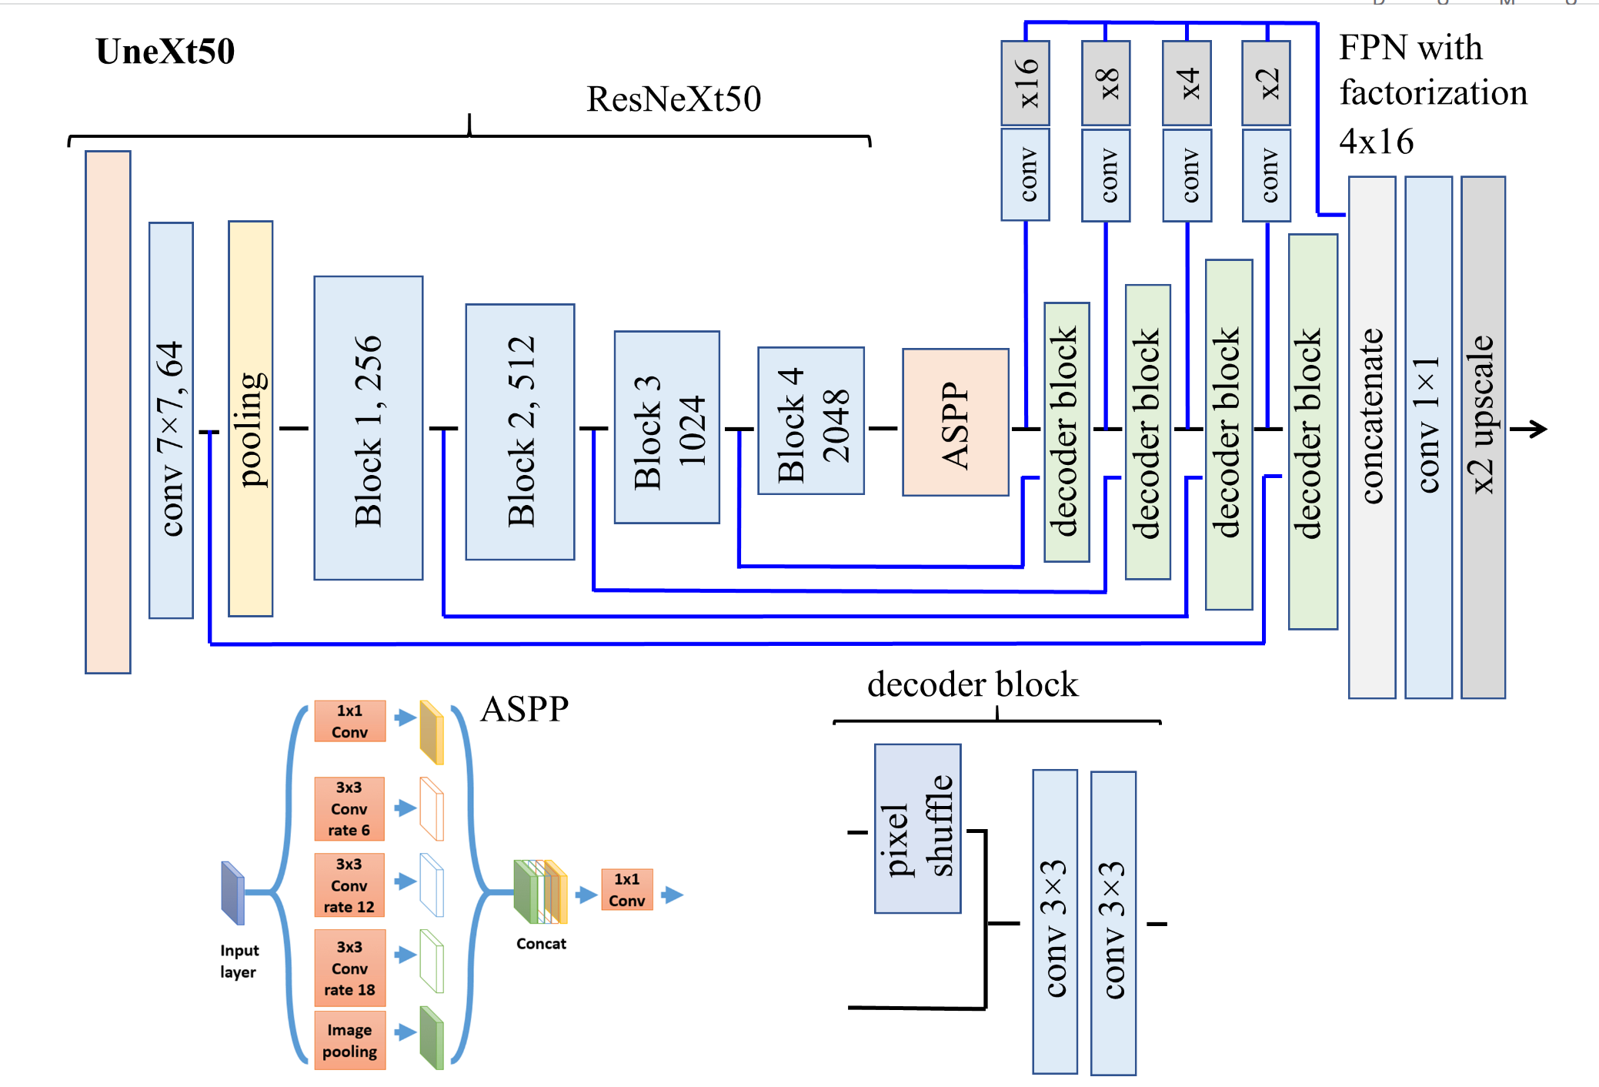
Part 1: A Introduction of A Better Baseline:
The Model Architecture of UNext50:
The model consists of three components:
1. Encoder Part (ResNeXt50)
2. ASPP
3. Decoder Part (FPN)
Notes:
Header: Uppercase, Calibri size 28, XJTLU Navy
Key Text: Title case, Calibri Bold size 14, Black
Charts and tables should use the XJTLU colour palette

Slide 4
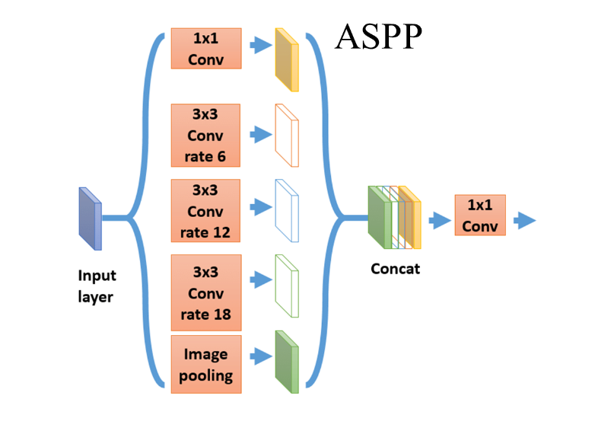
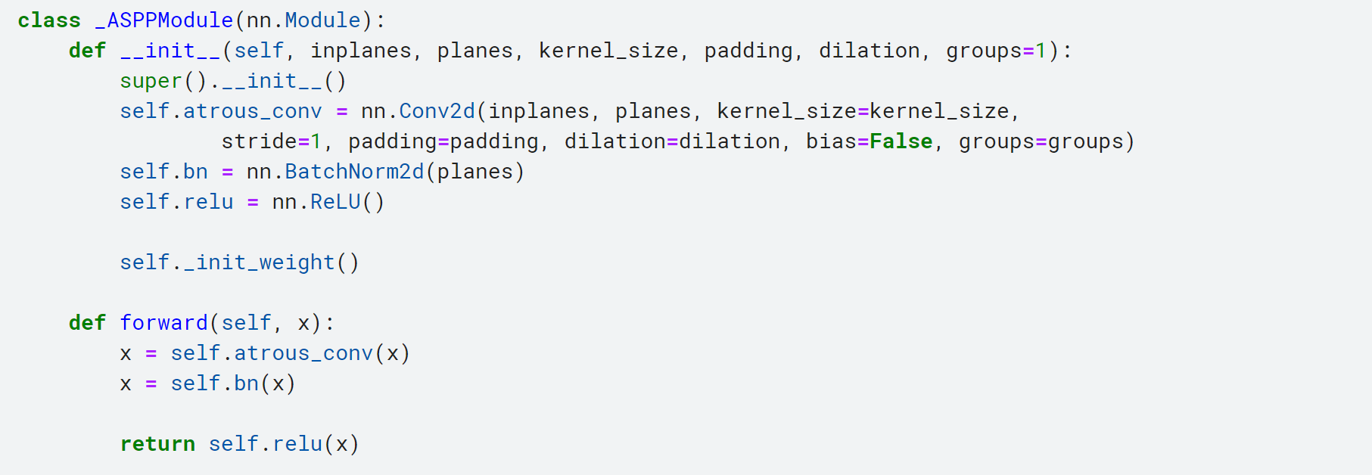
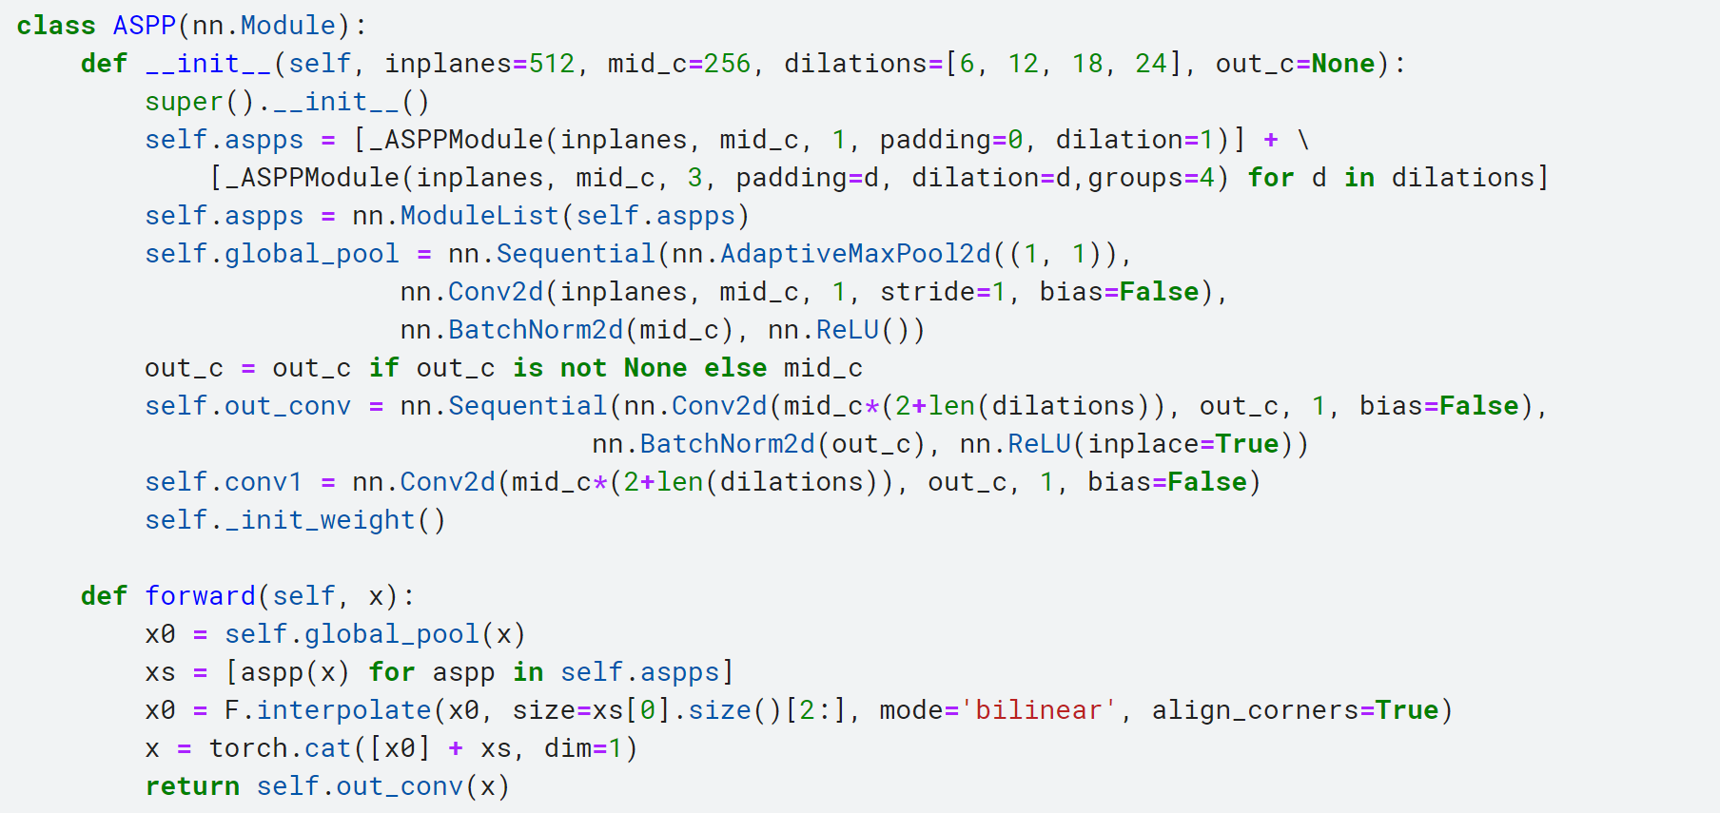
Part 1: A Introduction of A Better Baseline:
Atrous Spatial Pyramid Pooling (ASPP) block:
Notes:
Header: Uppercase, Calibri size 28, XJTLU Navy
Key Text: Title case, Calibri Bold size 14, Black
Charts and tables should use the XJTLU colour palette

Slide 5
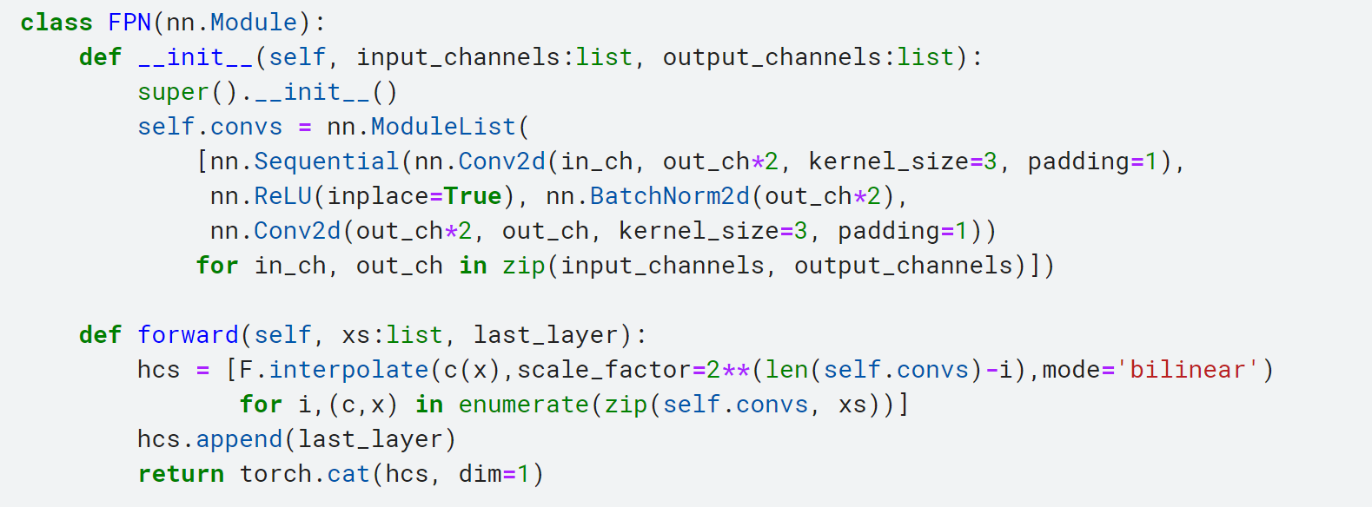
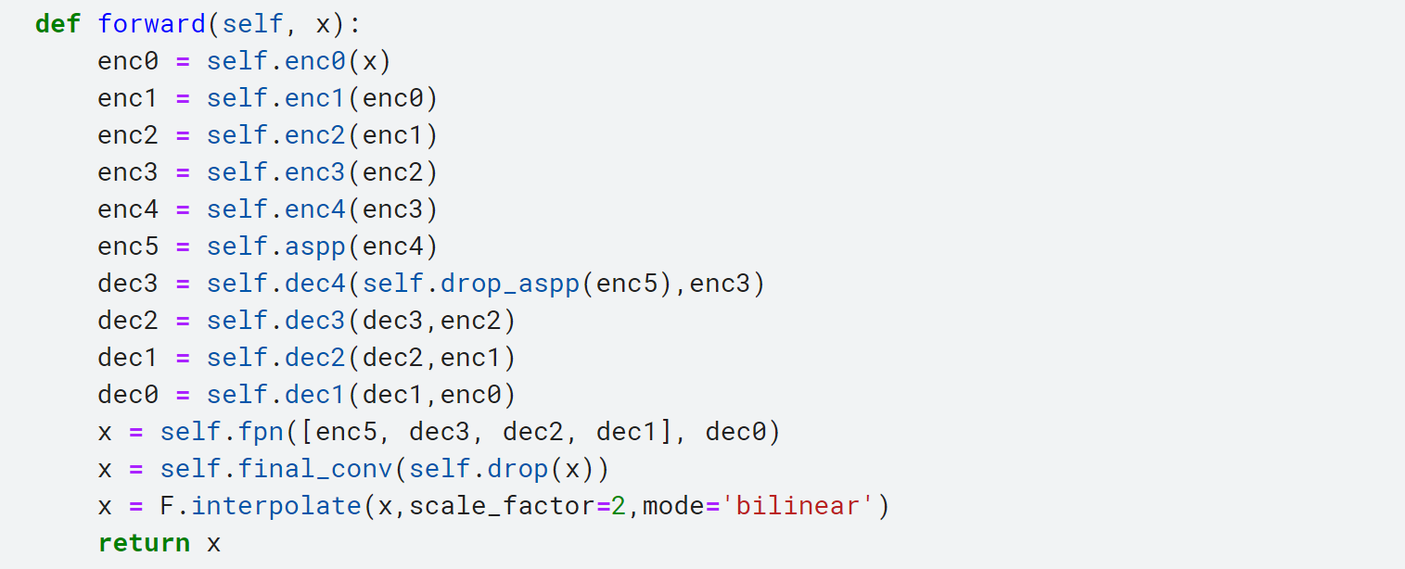
Part 1: A Introduction of A Better Baseline:
Feature Pyramid Network (FPN)
Notes:
Header: Uppercase, Calibri size 28, XJTLU Navy
Key Text: Title case, Calibri Bold size 14, Black
Charts and tables should use the XJTLU colour palette

Slide 6
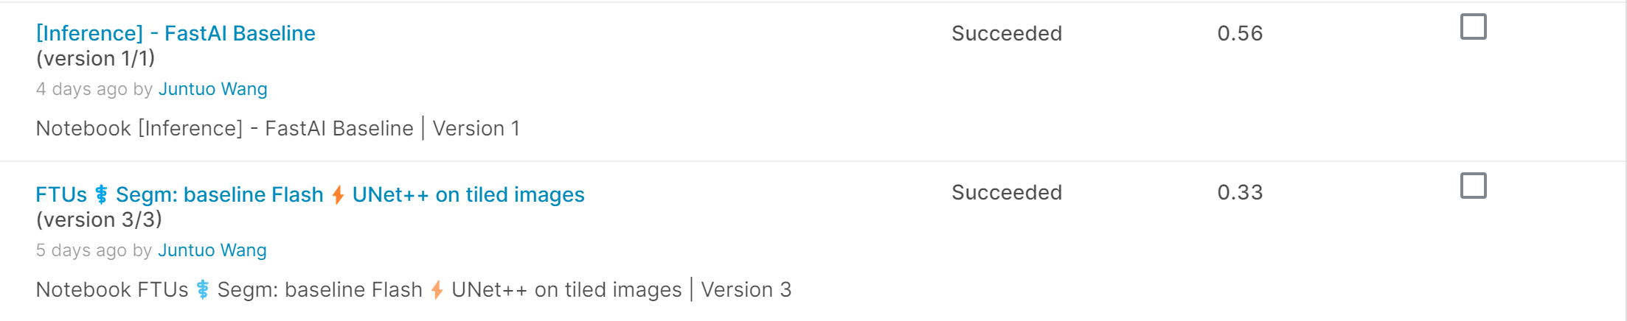

Part 2： Analysis of results
Evaluation:
The result of UNext50 is better than UNET++ and UNET
Notes:
Header: Uppercase, Calibri size 28, XJTLU Navy
Key Text: Title case, Calibri Bold size 14, Black
Charts and tables should use the XJTLU colour palette

Slide 7
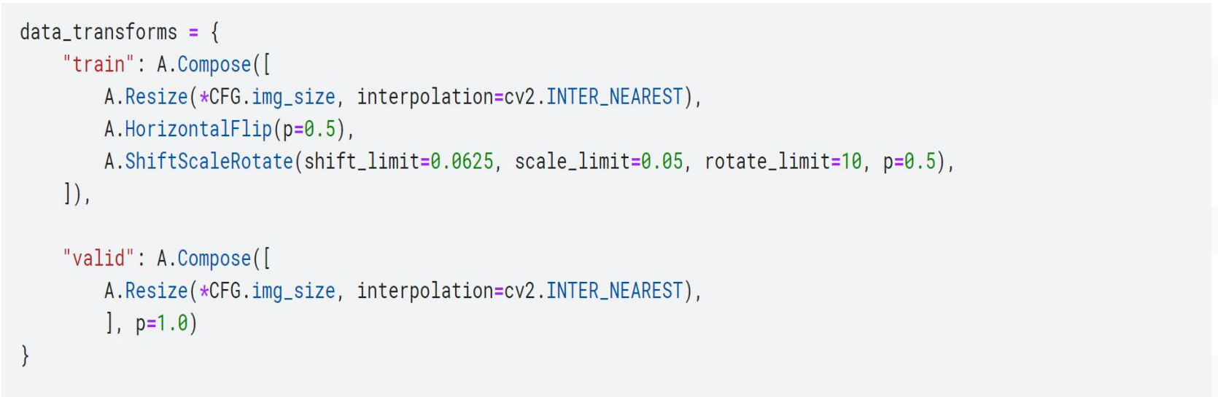
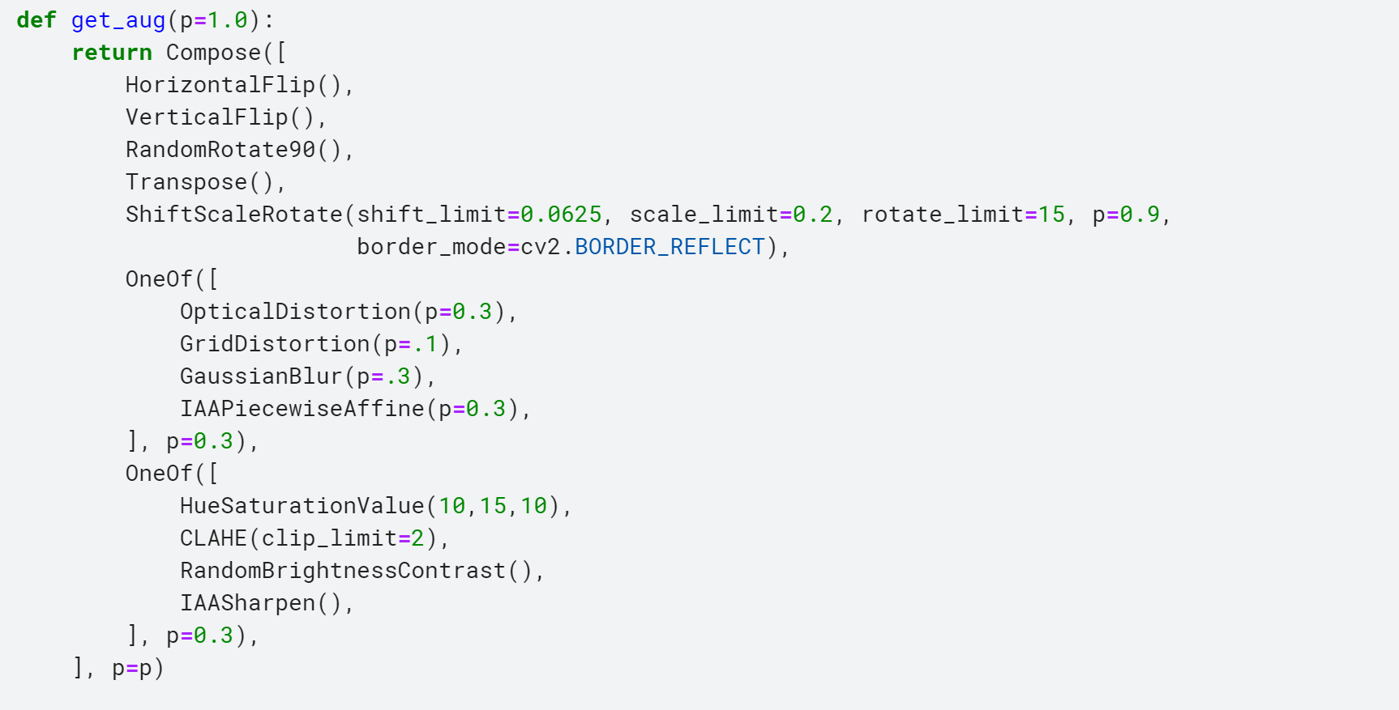
Part 2： Analysis of results
New Data Augmentation Strategis:
Result:
Before:
After:
Notes:
Header: Uppercase, Calibri size 28, XJTLU Navy
Key Text: Title case, Calibri Bold size 14, Black
Charts and tables should use the XJTLU colour palette

Slide 8
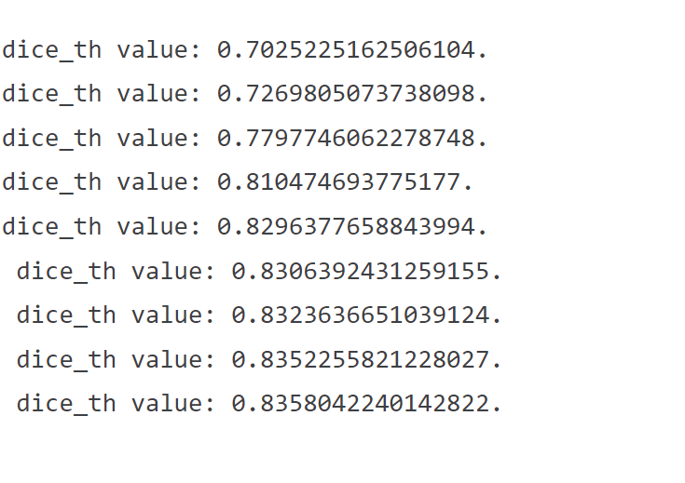
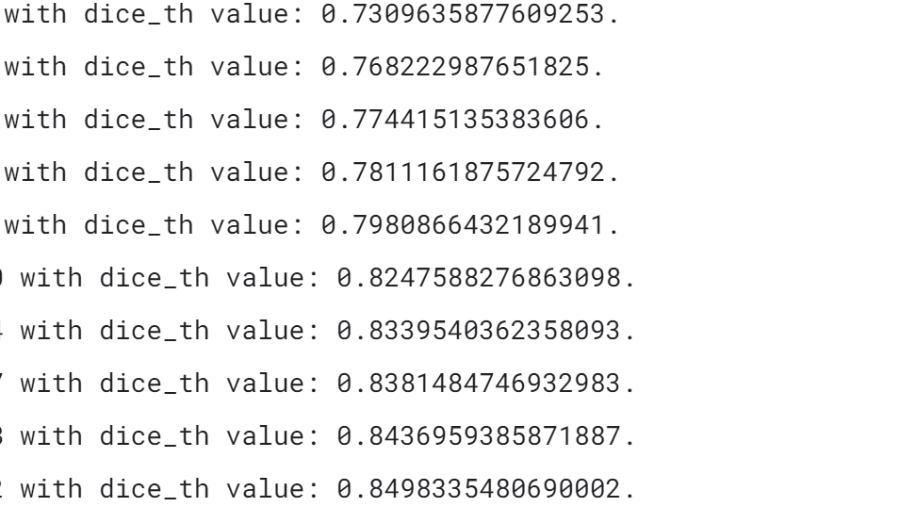
Part 2： Analysis of results
Result:
Before After
UNET++: 0.33 0.37
UNET: 0.28 0. 32
UNext50 (Still Training):
Notes:
Header: Uppercase, Calibri size 28, XJTLU Navy
Key Text: Title case, Calibri Bold size 14, Black
Charts and tables should use the XJTLU colour palette

Slide 9
Part 3：Future Plan
1. Change The Model:
SwinUnet, TransUNet etc.
2. Pretrain The Model On Other Similar Dataset
3. Try Some New Data Augmentation Strategies
Notes:
Header: Uppercase, Calibri size 28, XJTLU Navy
Key Text: Title case, Calibri Bold size 14, Black
Charts and tables should use the XJTLU colour palette

Slide 10
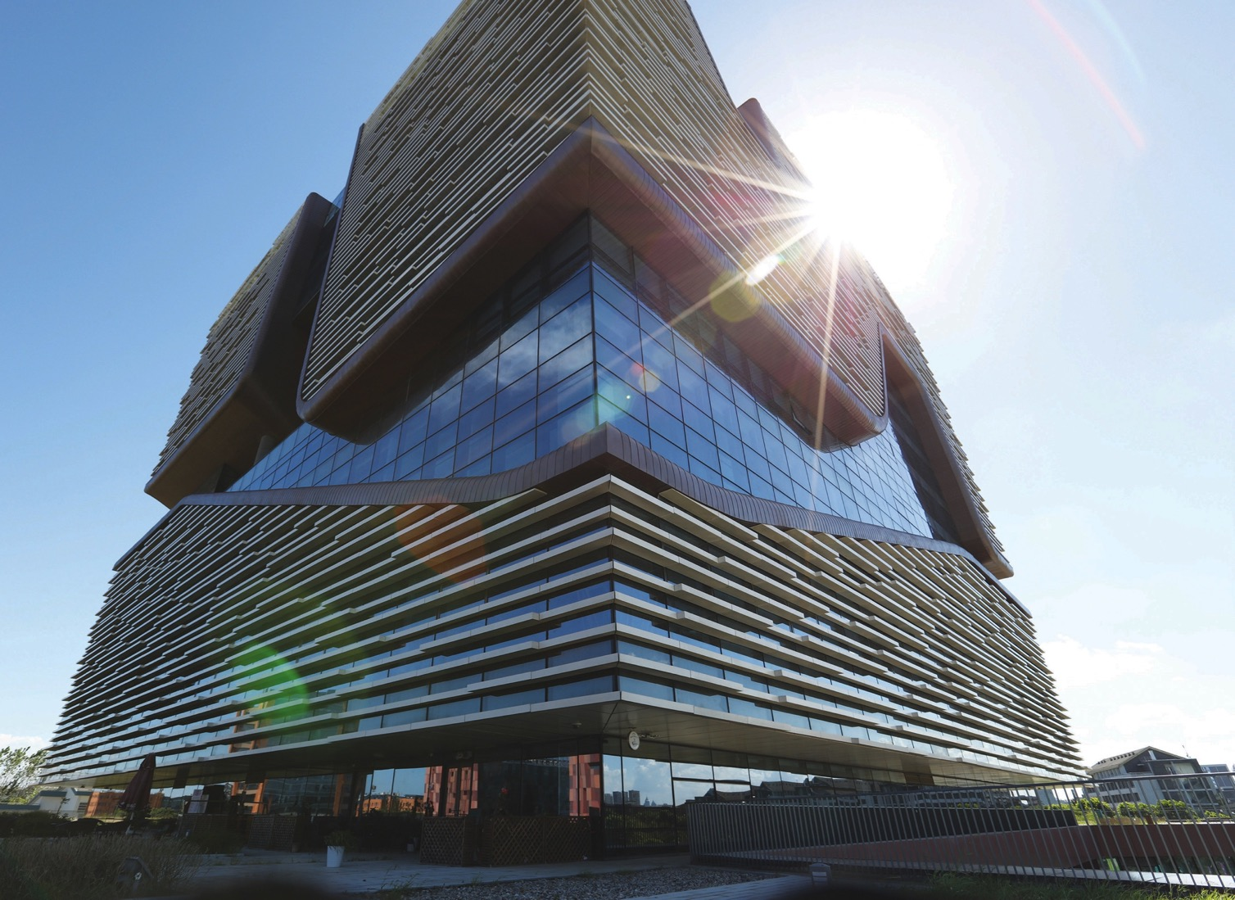
Thank you !

